Slide 1

Introduction To IoT – Unit 3

Slide 2
What is IoT
IoT stands for Internet of Things.
It refers to the interconnectedness of physical devices, such as appliances and vehicles, that are embedded with software, sensors, and connectivity which enables these objects to connect and exchange data.
This technology allows for the collection and sharing of data from a vast network of devices, creating opportunities for more efficient and automated systems.
IoT is network of interconnected computing devices which are embedded in everyday objects, enabling them to send and receive data.

Slide 3
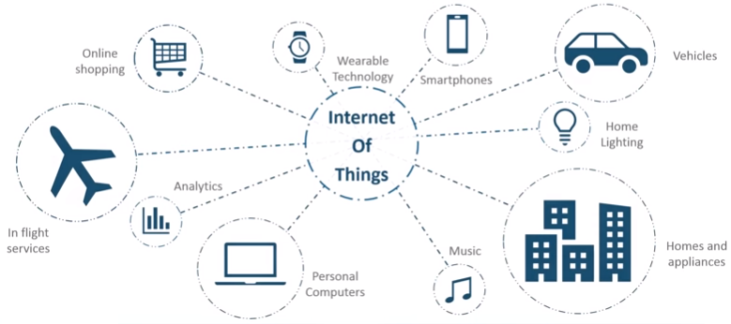
What is IoT
Connecting everyday things embedded with electronics, software, and sensors to internet enabling to collect and exchange data without human interaction called as the Internet of Things (IoT).

Slide 4
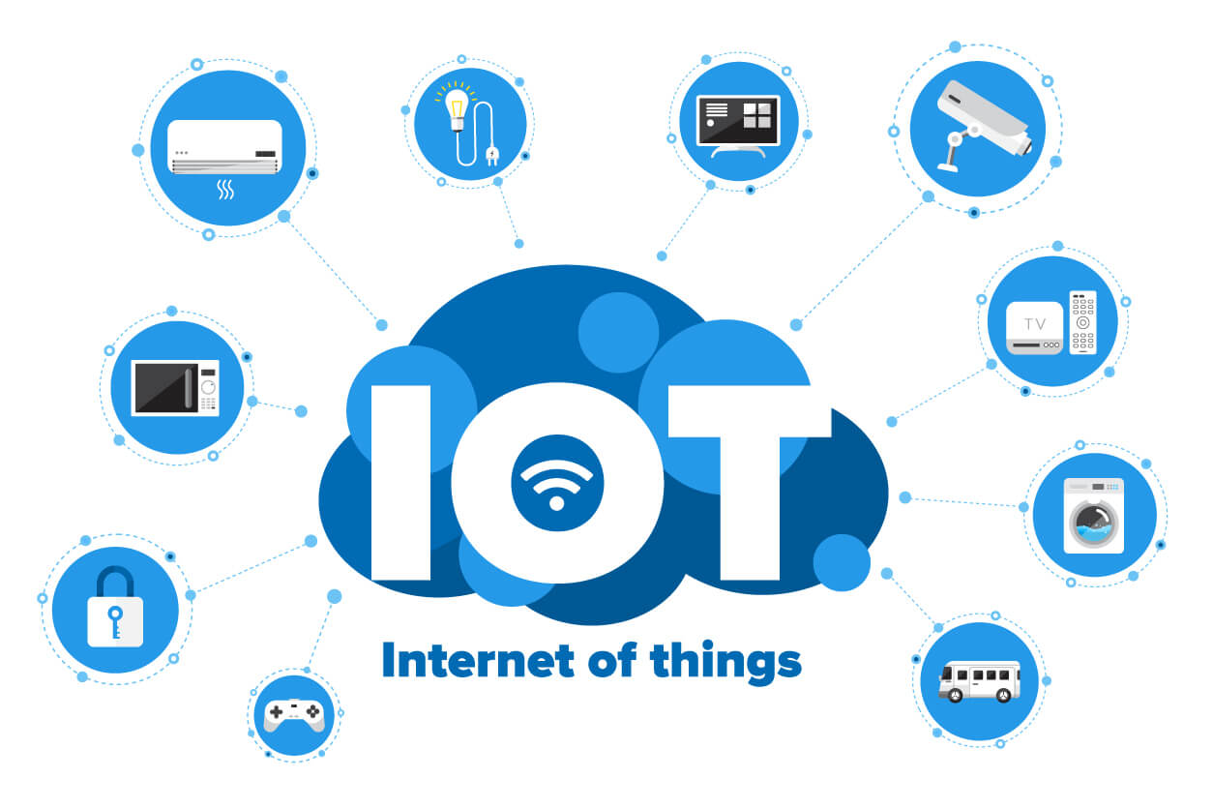
Thing?
A “Thing” in the context of IOT, is a entity or physical object that has unique identifier, an embedded system and ability to transfer data over the network.
These devices collect useful data with the help of various existing technologies and then autonomously flow the data between other devices

Slide 5
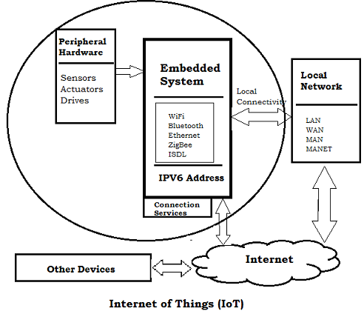
Embedded Systems in IoT
An embedded device system generally runs as a single application. these devices can connect through the internet connection, and able communicate through other network devices

Slide 6
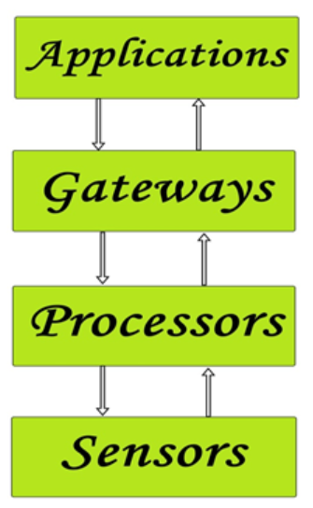
Building Blocks of IoT
Four things form the basic building blocks of the IoT system –sensors, processors, gateways, and applications.
Sensors
These form the front end of the IoT devices. These are the so-called “Things” of the system. Their main purpose is to collect data from its surroundings (sensors) or give out data to their surroundings (actuators).
These have to be uniquely identifiable devices with a unique IP address so that they can be easily identifiable over a large network.
These have to be active in nature which means that they should be able to collect real-time data. These can either work on their own (autonomous in nature) or can be made to work by the user depending on their needs (user-controlled).
Examples of sensors are gas sensor, water quality sensor, moisture sensor, etc.

Slide 7
Building Blocks of IoT
Processors
Processors are the brain of the IoT system. Their main function is to process the data captured by the sensors and process them so as to extract valuable data from the enormous amount of raw data collected. In a word, we can say that it gives intelligence to the data.
Processors mostly work on a real-time basis and can be easily controlled by applications. These are also responsible for securing the data – that is performing encryption and decryption of data.
Embedded hardware devices, microcontrollers, etc are the ones that process the data because they have processors attached to it.

Slide 8
Building Blocks of IoT
Gateways
Gateways are responsible for routing the processed data and sending it to proper locations for its (data) proper utilization.
In other words, we can say that the gateway helps in to and fro communication of the data. It provides network connectivity to the data. Network connectivity is essential for any IoT system to communicate.
LAN, WAN, PAN, etc are examples of network gateways.

Slide 9
Building Blocks of IoT
Applications
Applications form another end of an IoT system. Applications are essential for the proper utilization of all the data collected.
These cloud-based applications are responsible for rendering effective meaning to the data collected. Applications are controlled by users and are a delivery point of particular services.
Examples of applications are home automation apps, security systems, industrial control hubs, etc.

Slide 10
Characteristics of IoT
1. Connectivity
Connectivity is an important requirement of the IoT infrastructure. Things of IoT should be connected to the IoT infrastructure. Anyone, anywhere, anytime can connect, this should be guaranteed at all times. For example, the connection between people through Internet devices like mobile phones, and other gadgets, also a connection between Internet devices such as routers, gateways, sensors, etc.
2. Intelligence and Identity
The extraction of knowledge from the generated data is very important. For example, a sensor generates data, but that data will only be useful if it is interpreted properly. Each IoT device has a unique identity. This identification is helpful in tracking the equipment and at times for querying its status.
3. Scalability
The number of elements connected to the IoT zone is increasing day by day. Hence, an IoT setup should be capable of handling the massive expansion. The data generated as an outcome is enormous, and it should be handled appropriately.
4. Dynamic and Self-Adapting (Complexity)
IoT devices should dynamically adapt themselves to changing contexts and scenarios. Assume a camera meant for surveillance. It should be adaptable to work in different conditions and different light situations (morning, afternoon, and night).

Slide 11
Characteristics of IoT
5. Architecture
IoT Architecture cannot be homogeneous in nature. It should be hybrid, supporting different manufacturers ‘ products to function in the IoT network. IoT is not owned by anyone engineering branch. IoT is a reality when multiple domains come together.
6. Safety
There is a danger of the sensitive personal details of the users getting compromised when all his/her devices are connected to the internet. This can cause a loss to the user. Hence, data security is the major challenge. Besides, the equipment involved is huge. IoT networks may also be at risk. Therefore, equipment safety is also critical.
7. Self Configuring
This is one of the most important characteristics of IoT. IoT devices are able to upgrade their software in accordance with requirements with a minimum of user participation. Additionally, they can set up the network, allowing for the addition of new devices to an already-existing network.
8. Interoperability
IoT devices use standardized protocols and technologies to ensure they can communicate with each other and other systems. Interoperability is one of the key characteristics of the Internet of Things (IoT). It refers to the ability of different IoT devices and systems to communicate and exchange data with each other, regardless of the underlying technology or manufacturer.

Slide 12

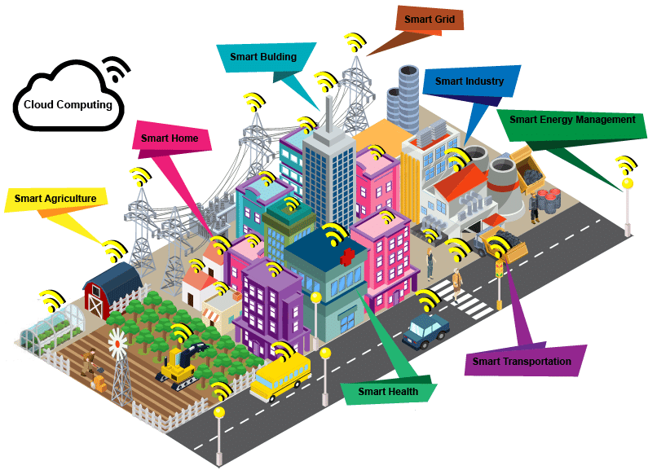
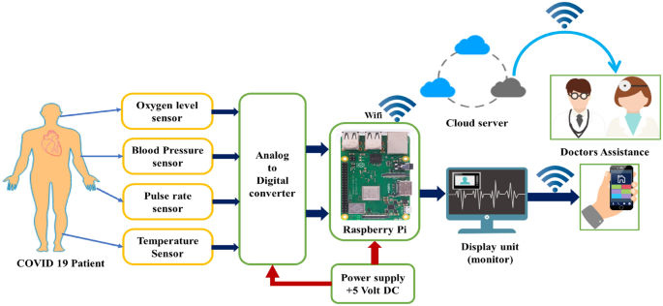
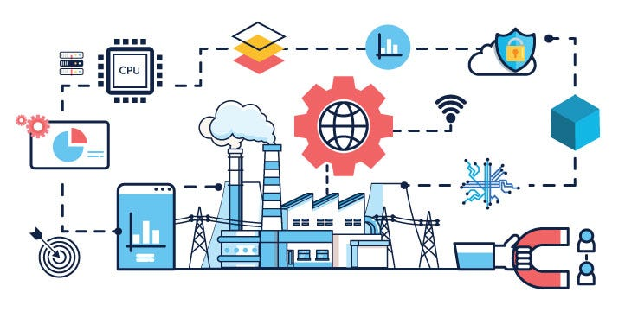
Case Studies and Applications
Example 1: Smart Cities
Real-time traffic management
Environmental monitoring
Example 2: Healthcare
Remote patient monitoring
Real-time diagnostics
Example 3: Industrial IoT
Predictive maintenance
Real-time quality control

Slide 13
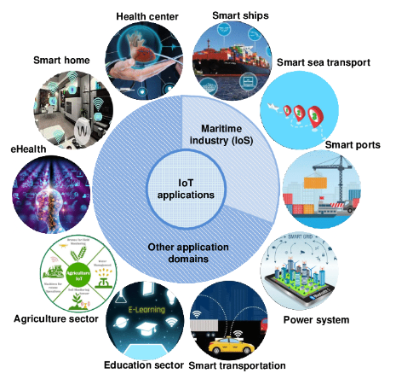

Slide 14
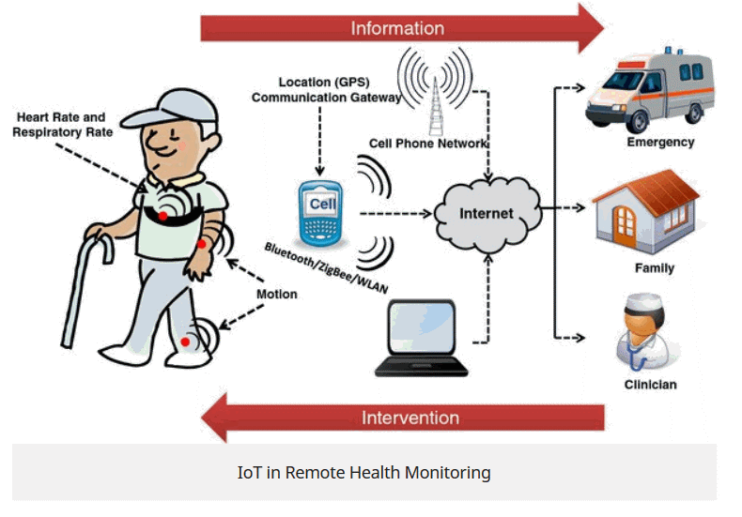
IoT in Health

Slide 15
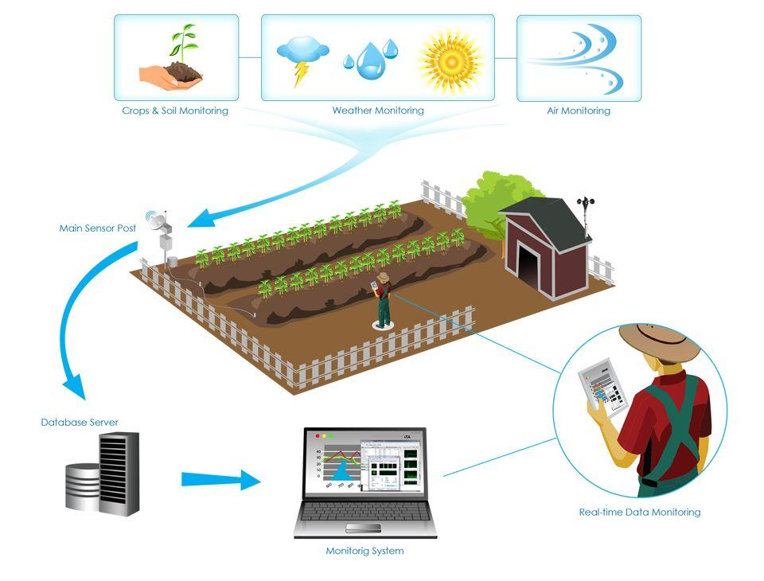
IoT in Agriculture

Slide 16
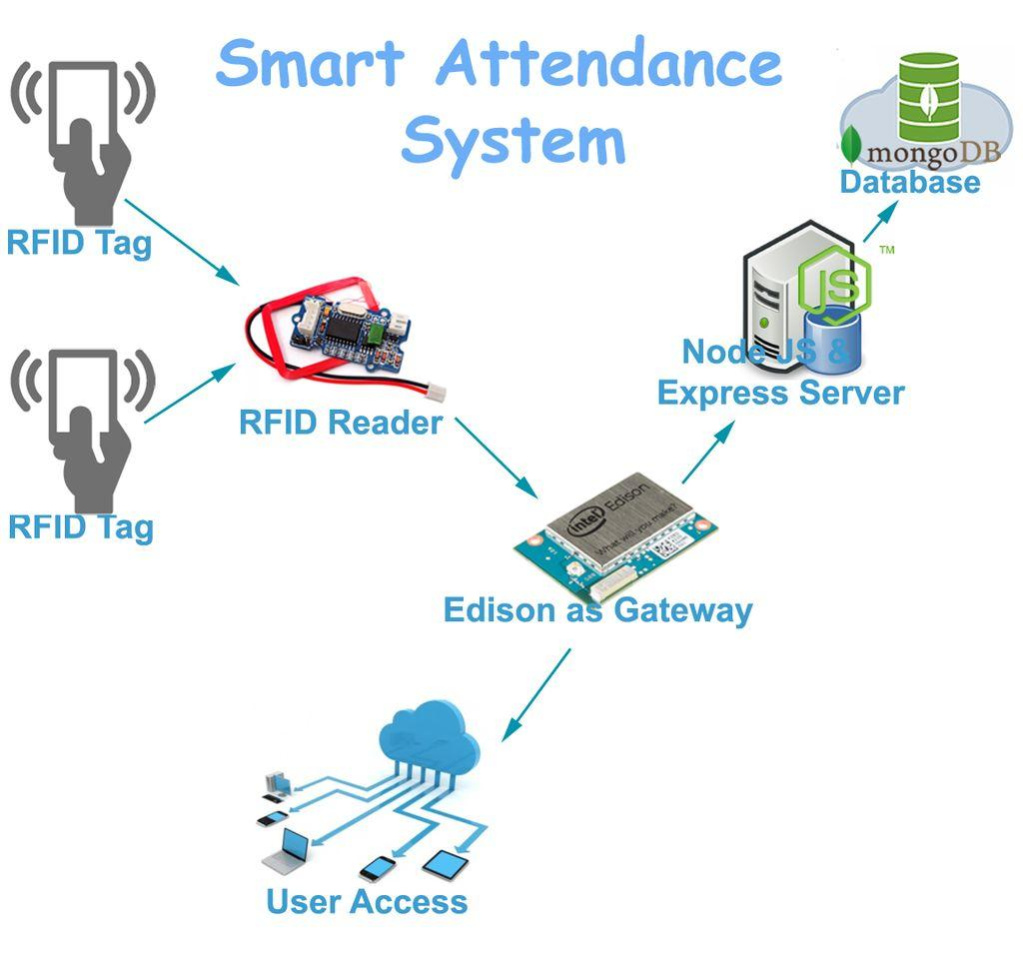
IoT in Education

Slide 17
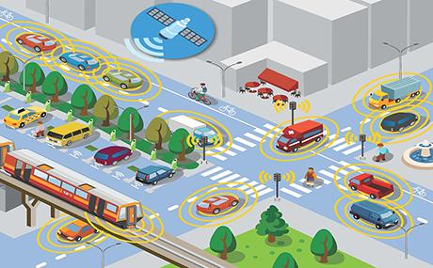
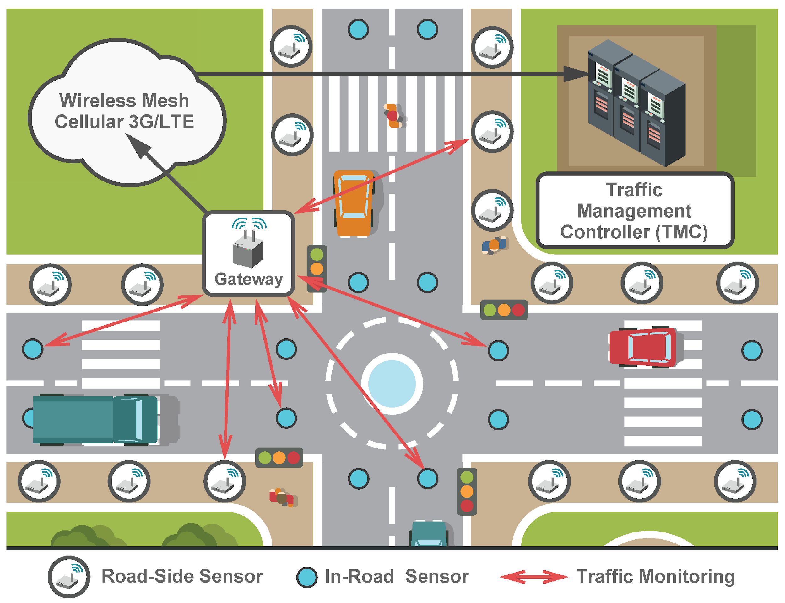
IoT in Traffic Control

Slide 18
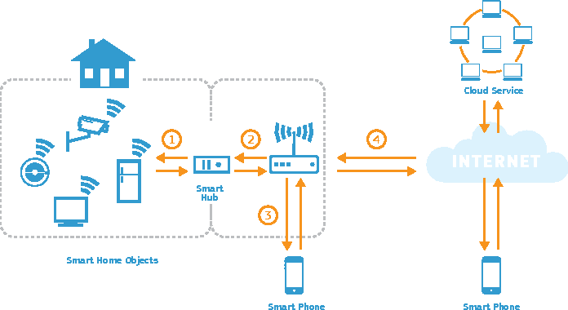
IoT in Smart Home

Slide 19
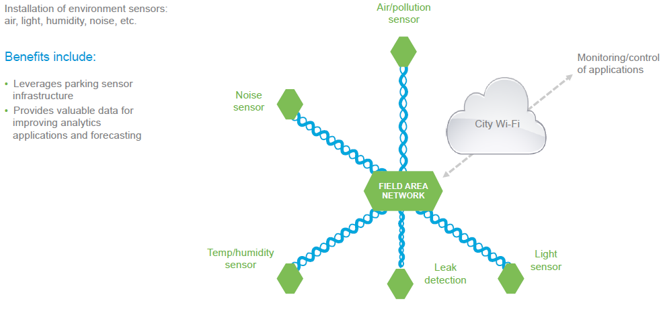
IoT in Pollution Tracking

Slide 20
Industrial IoT (IIOT)
Industrial IoT (IIoT) focusses on the use of cyber-physical systems to monitor the physical factory processes and make data-based automated decisions.
While the physical systems are made the intelligent using IoT, the real-time communication, and cooperation both with each other and with humans is established via the wireless web
IIoT brings in the concept of ‘a connected factory leads to a smart factory’.

Slide 21
IIOT in Manufacturing
Digital/connected factory: IoT enabled machinery can transmit operational information to the partners like original equipment manufacturers and to field engineers.
Facility management: The use of IoT sensors in manufacturing equipment enables condition-based maintenance alerts.
Production flow monitoring: IoT in manufacturing can enable the monitoring of production lines starting from the refining process down to the packaging of final products.
Inventory management: IoT applications permit the monitoring of events across a supply chain.

Slide 22
IIOT in Manufacturing
Plant Safety and Security: IoT combined big data analysis can improve the overall workers’ safety and security in the plant. .
Quality control: IoT sensors collect aggregate product data and other third-party syndicated data from various stages of a product cycle.
Packaging Optimization: By using IoT sensors in products and/or packaging, manufacturers can gain insights into the usage patterns and handling of product from multiple customers.
Logistics and Supply Chain Optimization: The Industrial IoT (IIoT) can provide access to real-time supply chain information by tracking materials, equipment, and products as they move through the supply chain.

Slide 23
Real-Time Analytics in IoT and Fog Computing
Layered Architecture, SOA, and API-Oriented Architecture

Slide 24
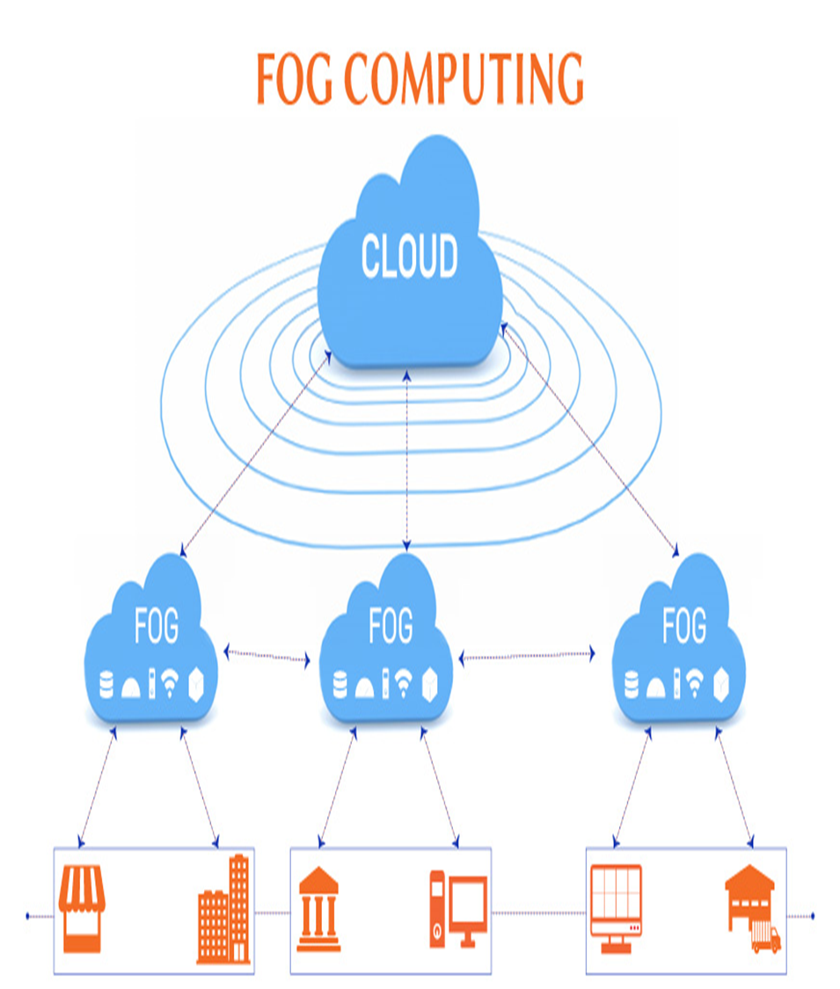
Introduction
What is IoT: Network of physical devices embedded with electronics, software's and sensors which enable these objects to connect and exchange data.
Fog Computing: Distributed computing infrastructure that brings computation, storage and networking closer to the source of data, at the edge of the network.
Challenge: Traditional cloud-based IoT solutions struggle with latency, bandwidth, and security.
Solution: Fog computing addresses these challenges by processing data closer to the source.

Slide 25
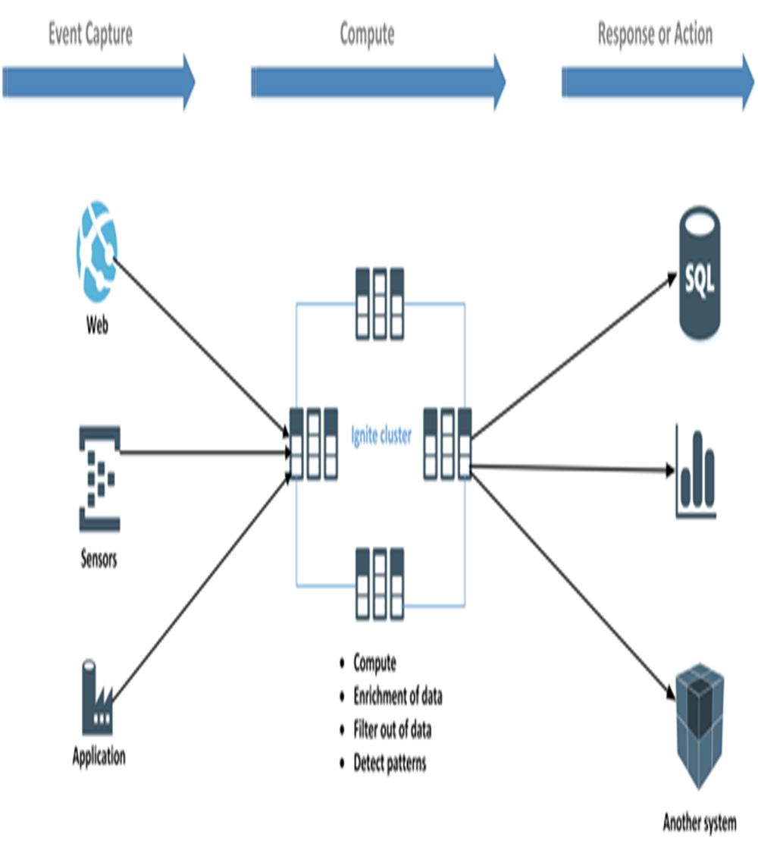
Real time analytics
Real-time analytics in IoT refers to the process of analysing data generated by connected devices as it arrives, without any delay.
IoT systems collect vast amounts of streaming data from millions of devices (sensors, wearables, industrial machines, etc.).
Through Real-time analytics process this data instantly, allows for timely insights and actions.
It’s crucial for applications where immediate decisions impact safety, efficiency, or performance.

Slide 26
The Need for Real-Time Analytics
Data Volume: IoT generates massive amounts of data.
Data Velocity: Data needs to be processed immediately to derive insights.
Data Variety: Data comes in various formats and structures.
Benefits of Real time analytics:
Improved decision-making.
Enhanced operational efficiency.
Predictive maintenance
Fraud detection
Personalized experiences

Slide 27
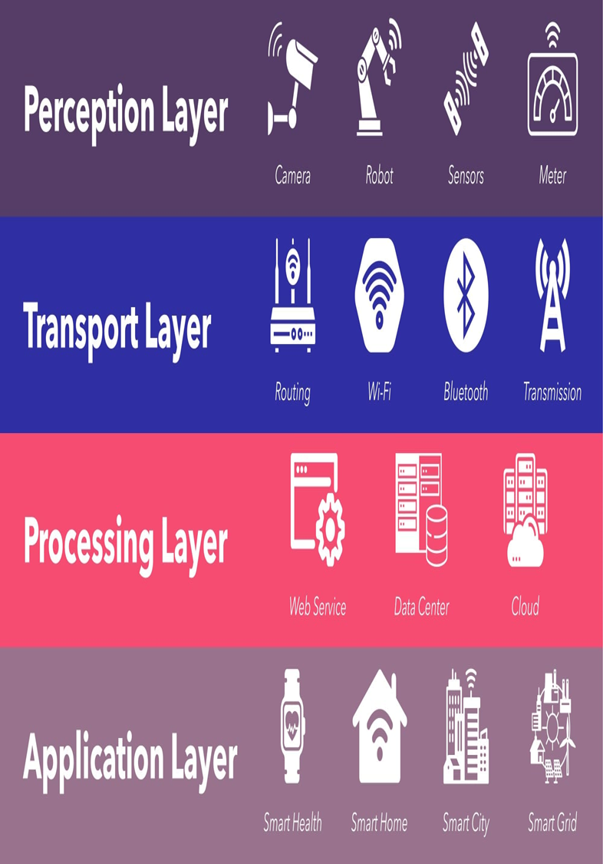
IoT Layered Architecture
Perception Layer: Sensors, actuators, and devices collect data from the physical world.
Transport Layer: Connectivity infrastructure (Wi-Fi, cellular, Bluetooth) for data transmission.
Processing Layer: Data aggregation, processing, and storage (fog and cloud).
Application Layer: Value-added services and applications based on processed data.

Slide 28
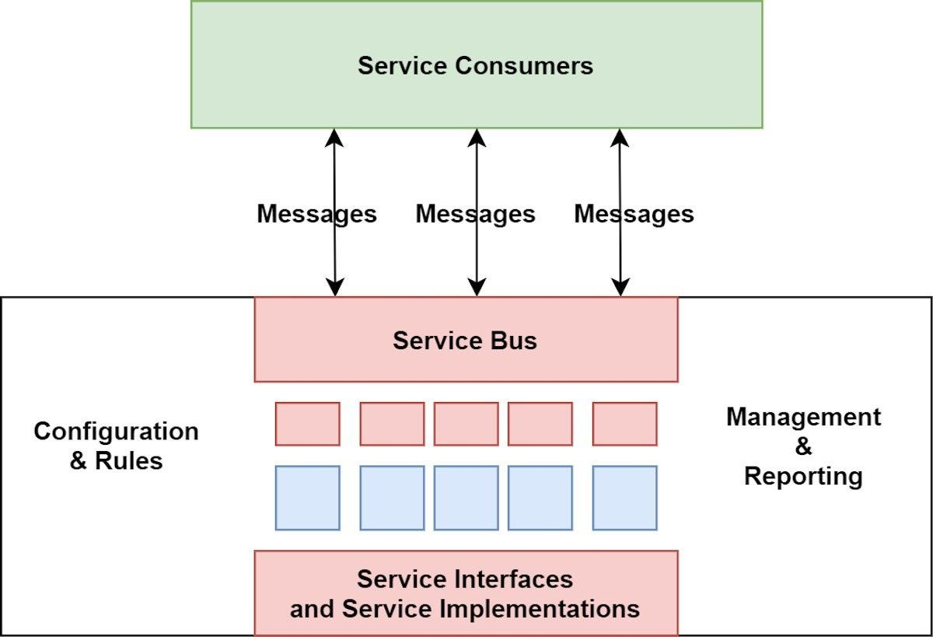
SOA-Based Architecture
Definition:
SOA(Service oriented Architecture) defines a way to make software components reusable using interfaces.
It allows applications to use services available in the network.
Key Points:
Services: A service is a discrete unit of functionality that can be accessed remotely and acted upon independently. For example, retrieving a credit card statement online.
Independence: SOA aims to be independent of vendors, products, and technologies.
Integration: SOA is commonly used for system integration.

Slide 29
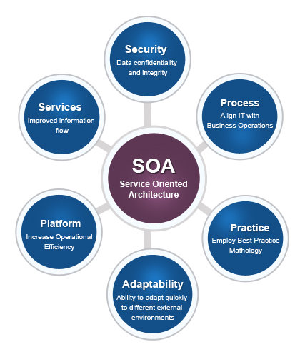
Benefits of SOA Architecture
Faster Time to Market:
Developers can reuse services across different business processes, saving time and costs.
Assembling applications becomes faster with SOA compared to building everything from scratch.
Efficient Maintenance:
SOA promotes smaller, modular services.
Updating, debugging, and modifying individual services is easier than dealing with large monolithic code blocks.
Changes to one service do not impact the overall functionality of the entire business process.
Greater Adaptability:
SOA is adaptable to technological advancements.
You can modernize applications efficiently and cost-effectively.
For example, older electronic health record systems can be integrated into newer cloud-based applications.
Interoperability:
Each service in SOA includes description documents specifying functionality and terms.
Any client system can run a service, regardless of the underlying platform or programming language.
Loose coupling ensures changes in one service do not affect others.
Reduced Redundancy:
SOA reduces redundancy by reusing services.
It increases usability, maintainability, and overall value.

Slide 30
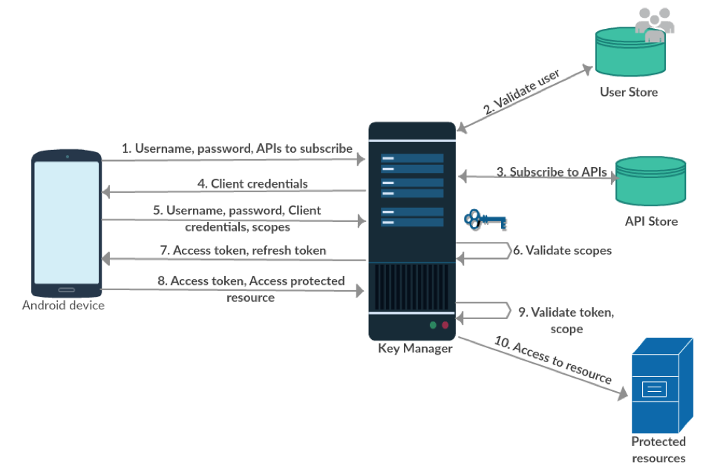
API-Oriented Architecture
API (Application Programming Interface) is a tool that software developers use to gather and transfer data between different applications or computers
Role in IoT:
Gathering Data: APIs allow communication between connected devices and applications, enabling data collection from the device.
Instructing Devices: APIs can instruct a connected device to perform specific actions remotely.
Since IoT devices can be located anywhere globally, APIs make it possible to access and utilize device data from a distance.

Slide 31
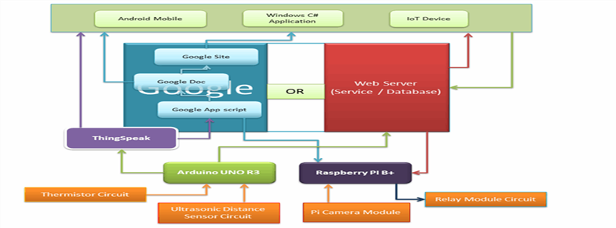
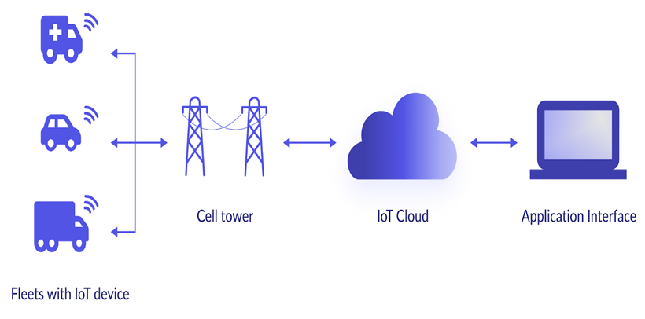
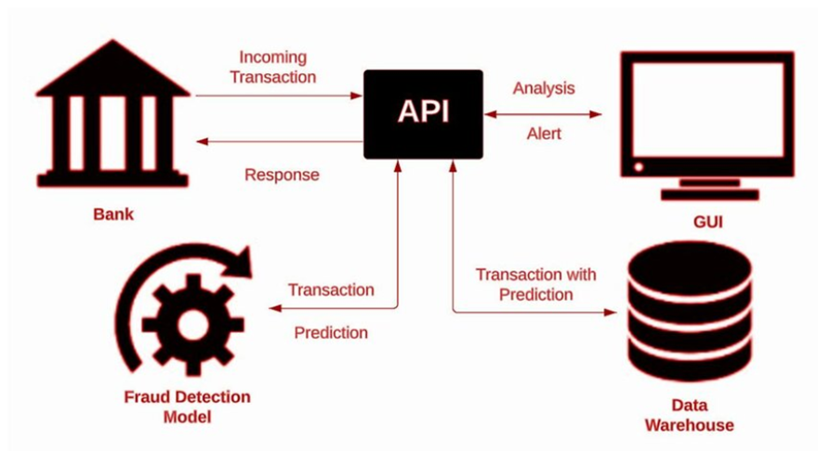
How API and IoT work together
APIs enable users to programmatically access information about their devices and make decisions based on that data.
Examples of API use in IoT:
Fleet Management: Activating devices, billing, and reporting are all done via APIs.
Fraud Prevention: Users can create alerts if a device is moved or if a SIM card is stolen.
Custom Applications: Developers leverage APIs to integrate IoT data into their own tools or applications.

Slide 32
IoT Challenges
IoT Security:
Connecting numerous devices to the internet introduces security risks. Each connected device becomes a potential entry point for hackers.
Challenges include managing device updates, securing communication (especially over unsecured Wi-Fi networks), and detecting vulnerabilities.
Device Compatibility:
IoT ecosystems involve diverse devices from various manufacturers. Ensuring seamless compatibility between them can be challenging.
Interoperability standards are crucial to enable devices to work together effectively.
Bandwidth Constraints:
As the number of connected devices grows, network bandwidth becomes a limitation.
Efficient data transmission and load balancing are necessary to prevent congestion.

Slide 33
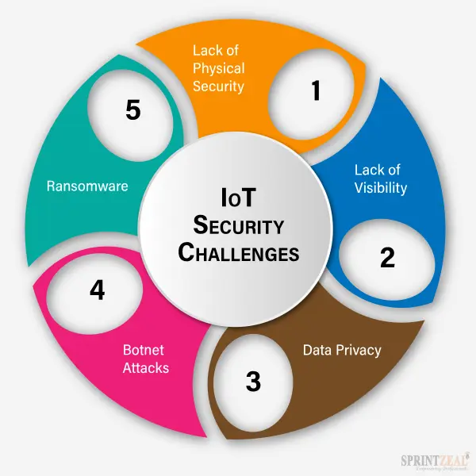

Slide 34
IoT Challenges
Security, privacy and data sharing issues
Because IoT devices are closely connected, all a hacker has to do is exploit one vulnerability to manipulate all the data, rendering it unusable. And manufacturers that don't update their devices regularly -- or at all -- leave them vulnerable to cybercriminals.
However, hackers aren't the only threat to the internet of things; privacy is another major concern for IoT users. For instance, companies that make and distribute consumer IoT devices could use those devices to obtain and sell users' personal data.

Slide 35
IoT Challenges
Interoperability
Interoperability refers to the ability of different systems, devices, or components to work together seamlessly and exchange data effectively.
Because IoT encompasses a wide array of devices, sensors, and platforms from various manufacturers and platform providers. Ensuring these devices can communicate and work together seamlessly is a significant challenge and can be costly for device certification. Interoperability standards such as MQTT and CoAP help, but organizations must still plan for integration, compatibility testing, and potential vendor lock-in.

Slide 36
IoT Challenges
Scalability
Scalability refers to the ability of a system to handle increasing workloads or numbers of users without a significant decline in performance.
IoT deployments are typically expected to scale from a handful of devices to thousands or even millions. Verifying the infrastructure can handle this scalability without compromising performance is a significant challenge. Issues such as data overload, network congestion, and efficient data processing and storage solutions need to be addressed early in the deployment process.

Slide 37
IoT Challenges
Reliability
Reliability refers to the ability of a system to perform its intended function consistently and without failure over time.
Ensuring 24/7 uptime, especially for IoT devices stationed in remote or challenging environments, presents unique challenges in IoT. Organizations must develop robust maintenance and remote monitoring strategies to address issues promptly and minimize downtime.

Slide 38
IoT Challenges
Power Management
Battery powered and low-power IoT devices require effective power management to provide long-lasting operation and minimize maintenance needs. This challenge is even more significant in remote or inaccessible locations, where power conservation becomes essential for optimal device performance and reliability.
Cost Management
While IoT promises efficiency gains, the initial investment can be significant. Balancing the cost of deployment with the expected benefits requires careful planning and cost analysis. Organizations must consider hardware, software, connectivity, and ongoing operational expenses

Slide 39

IOT Communication
The main goal of IoT is to enable communication between devices that are not traditional computers.
To interact with gateways, programs, servers and cloud platforms, IoT devices need to have connections as it allows devices to transmit and receive data across a network.
IoT allows these objects to send and receive data over a network. There are various protocols in IOT established to offer this communication.
Notes:
These processing systems are integrated with components dedicated to handling electric and/or mechanical interfacing.

Slide 40
IOT Communication Protocols
Bluetooth
Zigbee
Bluetooth Low Energy
Wi-Fi
Z-Wave
Cellular
Sigfox
RFID
Ethernet
Near Field Communication (NFC)
LPWAN
LoRaWAN
Notes:
These processing systems are integrated with components dedicated to handling electric and/or mechanical interfacing.

Slide 41
IOT Communication Protocols
Bluetooth
It’s effective for sending high-speed data for distances of up to 10 meters. Small amounts of data from wearables or sensors can be transmitted effectively using Bluetooth.
More than one third of IoT devices contain bluetooth connectivity.
Bluetooth is a form of wireless technology used for device communication and to make personal area networks(PANs).
The latest version is the bluetooth5 and it has features such as high range, speed and data broadcasting.
It has some empowering features that support IoT devices. Bluetooth low energy (BLE) supports devices that require less power and ideal for IoT enabled projects.
Notes:
These processing systems are integrated with components dedicated to handling electric and/or mechanical interfacing.

Slide 42
IOT Communication Protocols
Zigbee
ZIgbee is a WLAN and a wireless technology that aims to support extremely low power devices.
It supports these kinds of devices and makes it possible to connect them to the internet.
It is an open global standard and works on IEEE 802.15.4 physical radio standards.
IoT devices do not require extra functionality and Zigbee is an ideal protocol for transferring data from one communication point to another.
Zigbee makes data flow easy. It is used to send small amounts of data using very less power which is why it is used in machine to machine communication(M2M) and IoT.
Notes:
These processing systems are integrated with components dedicated to handling electric and/or mechanical interfacing.

Slide 43
IOT Communication Protocols
Bluetooth Low Energy (BLE)
BLE is a bluetooth that uses less power.
It is designed to support the internet of things.
BLE is energy efficient and offers better connectivity compared to other forms of technology such as Zigbee or LoRa.
BLE fits the need of data transfers as they are the only function that takes place in IoT sensors.
BLE is used in the making of smartwatches, medical devices, fitness trackers, beacons and home automation devices.
BLE consumes less power and has less bandwidth.
Notes:
These processing systems are integrated with components dedicated to handling electric and/or mechanical interfacing.

Slide 44
IOT Communication Protocols
WiFi
Wifi is a form of local area network for wireless communication.
It is a better option for data transfers as it easily fits into a variety of standards.
It plays an important role in IoT communication and intercommunication with other cellular networks such as Bluetooth.
Wifi supports high bandwidth and low latency.
It’s common in households and workplaces due to its low operating costs and works in the frequency of 2.4GHz and 5 GHz.
Notes:
These processing systems are integrated with components dedicated to handling electric and/or mechanical interfacing.

Slide 45
IOT Communication Protocols
Z-Wave
Z-wave is a wireless messaging protocol to communicate between various IoT devices.
It is useful especially in home automation to connect appliances in smart homes. Z-wave offers a two-way mode of communication empowered with mesh networking and message received acknowledgment.
Z-wave is a low-cost technology that eliminates issues caused by Wifi and Bluetooth.
The network of Z-wave includes the internet of things devices and control called the primary hub.
When z-hub receives a message via a smartphone or tablet it sends this message to the relevant smart home appliance.
Notes:
These processing systems are integrated with components dedicated to handling electric and/or mechanical interfacing.

Slide 46
IOT Communication Protocols
RFID
Radio frequency identification system is a technology that supports the identification of objects via radio waves.
By connecting the RFID reader to the terminal of the internet, users can identify, monitor and track the object with tags.
RFID is fast, dependent and does not require physical interaction between the user and the tagged item.
It identifies IoT objects by tagging and labelling them. The tag or label replaces the object.
RFID is useful to identify, track and monitor remote IoT objects with time and location.
Notes:
These processing systems are integrated with components dedicated to handling electric and/or mechanical interfacing.

Slide 47
IOT Communication Protocols
Cellular
Cellular connects the devices to anything and everything without the need for smartphones or gateway.
This means it connects devices directly to the base station without any intermediaries.
These connections are always present even in remote areas.
Cellular IoT makes it possible to construct less power-consuming devices that connect to the internet which was not possible before.
There are cellular communication subtypes like LTE-M and NB-IoT that offer more data capacity and less power consumption. These subtypes are designed to enable IoT devices that require a long battery life or are used in places where conventional 4G technology is challenging to access.
Notes:
These processing systems are integrated with components dedicated to handling electric and/or mechanical interfacing.

Slide 48
IOT Communication Protocols
Sigfox
Sigfox was the first to introduce LPWAN technologies in the development of IoT projects. It uses a low-power wide area network to intercommunicate between IoT devices via the internet. It supports long-distance communication for sending and receiving small messages.
For machine-to-machine (M2M) applications, Sigfox is the best long-range network since it uses less power than other long-range networks. This makes it an excellent option for connecting remote devices that must operate on batteries for extended periods without being charged.
Sigfox operates in the industrial, scientific and medical (ISM) bands using an ultra-narrow band (UNB) technology, with a specialized infrastructure
Notes:
These processing systems are integrated with components dedicated to handling electric and/or mechanical interfacing.

Slide 49
IOT Communication Protocols
Ethernet
Ethernet is a communication standard that was developed in the early 80s to network between local devices and computers.
The local environment is labeled as a local area network(LAN).
LAN creates a common environment for devices to receive and share information among one another.
Ethernet however offers a wired form of communication. Since it does not offer wireless communication the set becomes a bit costly and is not the ideal option for IoT communication.
Notes:
These processing systems are integrated with components dedicated to handling electric and/or mechanical interfacing.

Slide 50
IOT Communication Protocols
Near Field Communication (NFC)
NFC stands for near-field communication.
It is a wireless technology for short-distance communication.
However, the NFC-enabled devices must be in close proximity to each other so that they can communicate via radio waves.
One of the devices should be an active device such as a smartphone or tablet and the other device can be passive such as an NFC tag.
The active devices require an external power supply while the passive devices do not.
Notes:
These processing systems are integrated with components dedicated to handling electric and/or mechanical interfacing.

Slide 51
IOT Communication Protocols
LPWAN
LPWAN stands for low power wide area network.
It offers wireless communication between devices that consume less amounts of power.
It connects these devices to the internet to send and receive messages from devices within the same network.
Some examples of LPWAN are sigfox and LoRa.
LPWAN allows communication across a minimum of 500 meters, consumes little power and enables long-distance connectivity.
Notes:
These processing systems are integrated with components dedicated to handling electric and/or mechanical interfacing.

Slide 52
IOT Communication Protocols
LoRaWAN
Low range wide area network or LoRaWAN is a wide area network protocol.
It was constructed to connect objects to the internet and to act as a mode of communication between these objects.
These objects could be home automation devices, smart cars, thermostats and so on.
Millions of low-power, low-memory devices are used in smart cities, where this communication protocol is mostly employed.
Notes:
These processing systems are integrated with components dedicated to handling electric and/or mechanical interfacing.

Slide 53
Cloud Computing
What is Cloud Computing?
Cloud Computing means storing and accessing the data and programs on remote servers that are hosted on the internet instead of the computer’s hard drive or local server.
Cloud computing is also referred to as Internet-based computing, it is a technology where the resource is provided as a service through the Internet to the user.
The data that is stored can be files, images, documents, or any other storable document.
The following are some of the Operations that can be performed with Cloud Computing
Storage, backup, and recovery of data
Delivery of software on demand
Development of new applications and services
Streaming videos and audio
Notes:
These processing systems are integrated with components dedicated to handling electric and/or mechanical interfacing.

Slide 54
Cloud Computing
What is Cloud Computing?
Cloud computing helps users in easily accessing computing resources like storage, and processing over internet rather than local hardwares. How cloud computing works, explained as:
Infrastructure: Cloud computing depends on remote network servers hosted on internet for store, manage, and process the data.
On-Demand Access: Users can access cloud services and resources based on-demand they can scale up or down without having to invest for physical hardware.
Types of Services: Cloud computing offers various benefits such as cost saving, scalability, reliability and accessibility it reduces capital expenditures, improves efficiency.
Notes:
These processing systems are integrated with components dedicated to handling electric and/or mechanical interfacing.

Slide 55
Cloud Computing
Architecture of Cloud Computing
Cloud computing architecture refers to the components and sub-components required for cloud computing. These components typically refer to:
Front end ( Fat client, Thin client)
Back-end platforms ( Servers, Storage )
Cloud-based delivery and a network ( Internet, Intranet, Intercloud )
Notes:
These processing systems are integrated with components dedicated to handling electric and/or mechanical interfacing.

Slide 56
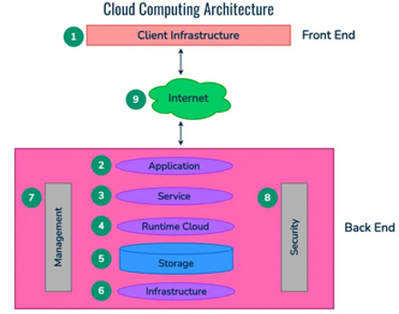
Cloud Computing
Architecture of Cloud Computing
.
Notes:
These processing systems are integrated with components dedicated to handling electric and/or mechanical interfacing.

Slide 57
Cloud Computing
Architecture of Cloud Computing
1. Front End ( User Interaction Enhancement ):
The User Interface of Cloud Computing consists of 2 sections of clients. The Thin clients are the ones that use web browsers facilitating portable and lightweight accessibilities and others are known as Fat Clients that use many functionalities for offering a strong user experience.
2. Back-end Platforms (Cloud Computing Engine)
The core of cloud computing is made at back-end platforms with several servers for storage and processing computing. Management of Applications logic is managed through servers and effective data handling is provided by storage. The combination of these platforms at the backend offers the processing power, and capacity to manage and store data behind the cloud.
3. Cloud-Based Delivery and Network
On-demand access to the computer and resources is provided over the Internet, Intranet, and Intercloud. The Internet comes with global accessibility, the Intranet helps in internal communications of the services within the organization and the Intercloud enables interoperability across various cloud services. This dynamic network connectivity ensures an essential component of cloud computing architecture on guaranteeing easy access and data transfer.
Notes:
These processing systems are integrated with components dedicated to handling electric and/or mechanical interfacing.

Slide 58
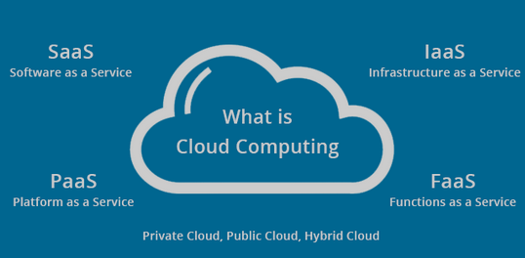
Cloud Computing
Cloud Computing Services
Infrastructure as a Service (IaaS)
Platform as a Service (PaaS)
Software as a Service (SaaS)
Function as a Service (FaaS)
Notes:
These processing systems are integrated with components dedicated to handling electric and/or mechanical interfacing.

Slide 59
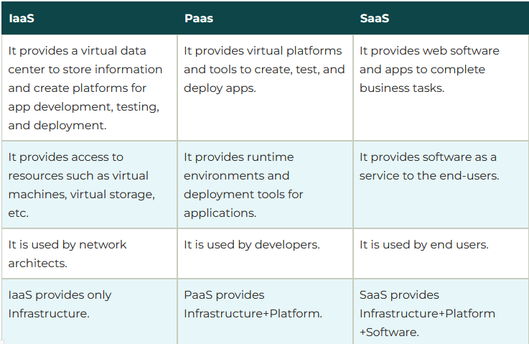
Cloud Computing
Notes:
These processing systems are integrated with components dedicated to handling electric and/or mechanical interfacing.

Slide 60
Cloud Computing
Cloud Computing Characteristics
The following are the characteristics of Cloud Computing:
Scalability: With Cloud hosting, it is easy to grow and shrink the number and size of servers based on the need. This is done by either increasing or decreasing the resources in the cloud. This ability to alter plans due to fluctuations in business size and needs is a superb benefit of cloud computing, especially when experiencing a sudden growth in demand.
Save Money: An advantage of cloud computing is the reduction in hardware costs. Instead of purchasing in-house equipment, hardware needs are left to the vendor. For companies that are growing rapidly, new hardware can be large, expensive, and inconvenient. Cloud computing alleviates these issues because resources can be acquired quickly and easily.
Reliability: Rather than being hosted on one single instance of a physical server, hosting is delivered on a virtual partition that draws its resource, such as disk space, from an extensive network of underlying physical servers. If one server goes offline it will have no effect on availability, as the virtual servers will continue to pull resources from the remaining network of servers.
Physical Security: The underlying physical servers are still housed within data centers and so benefit from the security measures that those facilities implement to prevent people from accessing or disrupting them on-site.
Notes:
These processing systems are integrated with components dedicated to handling electric and/or mechanical interfacing.

Slide 61
Cloud Computing
Advantages
Cost Efficiency
Flexibility and Scalability
Collaboration and Accessibility
Automatic Maintenance and Updates
Disadvantages
Security Concerns
Server Down Problems
Dependency on Internet Connectivity
Cost Management Complexity
Notes:
These processing systems are integrated with components dedicated to handling electric and/or mechanical interfacing.

Slide 62
Big Data
Big Data
Big data refers to the data which is huge in size and also increasing rapidly with respect to time.
Big data includes structured data, unstructured data as well as semi-structured data. Big data can not be stored and processed in traditional data management tools it needs specialized big data management tools.
It refers to complex and large data sets having 5 V’s volume, velocity, Veracity, Value and variety information assets. It includes data storage, data analysis, data mining and data visualization.
Examples of the sources where big data is generated includes social media data, e-commerce data, weather station data, IoT Sensor data etc.
Notes:
These processing systems are integrated with components dedicated to handling electric and/or mechanical interfacing.

Slide 63
Big Data
Big Data
Characteristics of Big Data :
Variety of Big data – Structured, unstructured, and semi structured data
Velocity of Big data – Speed of data generation
Volume of Big data – Huge volumes of data that is being generated
Value of Big data – Extracting useful information and making it valuable
Variability of Big data – Inconsistency which can be shown by the data at times.
Notes:
These processing systems are integrated with components dedicated to handling electric and/or mechanical interfacing.

Slide 64
Big Data
Types of Big Data
1. Structured
Structured data are defined as the data which can be stored, processed and accessed in a fixed format. Structured data has a fixed schema and thus can be processed easily. We can use SQL to manage structured data.
Example of Structured Data: Data stored in RDBMS.
2. Semi-Structured
Semi-Structured data are the data that do not have any formal structure like table definition in RDBMS, but they have some organizational properties like markers and tags to separate semantic elements thus, making it easier for analysis.
Example of Semi-Structured Data: XML files or JSON documents.
3. Unstructured:
Unstructured data have unknown form or structure and cannot be stored in RDBMS. We cannot analyze unstructured data until they are transformed into a structured format. 80 % of the data generated by the organizations are unstructured.
Example of Unstructured Data: Text files, multimedia contents like audio, video, images, etc.
Notes:
These processing systems are integrated with components dedicated to handling electric and/or mechanical interfacing.

Slide 65
Big Data
Big Data Examples
The New York Stock Exchange (NYSE) produces one terabyte of new trade data every day.
Each day 500 million tweets are sent.
Amazon, in order to recommend products, on average, handles more than 15 million+ customer clickstreams per day.
Walmart an American Multinational Retail Corporation handle about 1 million+ customer transactions per hour.
65 billion+ messages are sent on Whatsapp every day.
A single Jet engine generates more than 10 terabytes of data in-flight time of 30 minutes.
On average, everyday 294 billion+ emails are sent.
Modern cars have close to 100 sensors for monitoring tire pressure, fuel level, etc. , thus generating a lot of sensor data.
Facebook stores and analyzes more than 30 Petabytes of data generated by the users each day.
YouTube users upload about 48 hours of video every minute of the day.
Notes:
These processing systems are integrated with components dedicated to handling electric and/or mechanical interfacing.

Slide 66
Big Data
Big Data Applications
Big Data finds applications in many domains in various industries. The article enlisted some of the applications in brief. 1. Bank and Finance: In the banking and Finance sectors, it helps in detecting frauds, managing risks, and analyzing abnormal trading.
2. Agriculture: In agriculture sectors, it is used to increase crop efficiency. It can be done by planting test crops to store and record the data about crops’ reaction to different environmental changes and then using that stored data for planning crop plantation accordingly.
3. Advertising and Marketing: Advertising agencies use Big Data to understand the pattern of user behavior and collect information about customers’ interests.
4. Media and Entertainment: Media and Entertainment industries are using big data analysis to target the interested audience. They now understand the kind of advertisements that attract a customer as well as the most appropriate time for broadcasting the advertisements to seek maximum attention.
Notes:
These processing systems are integrated with components dedicated to handling electric and/or mechanical interfacing.

Slide 67
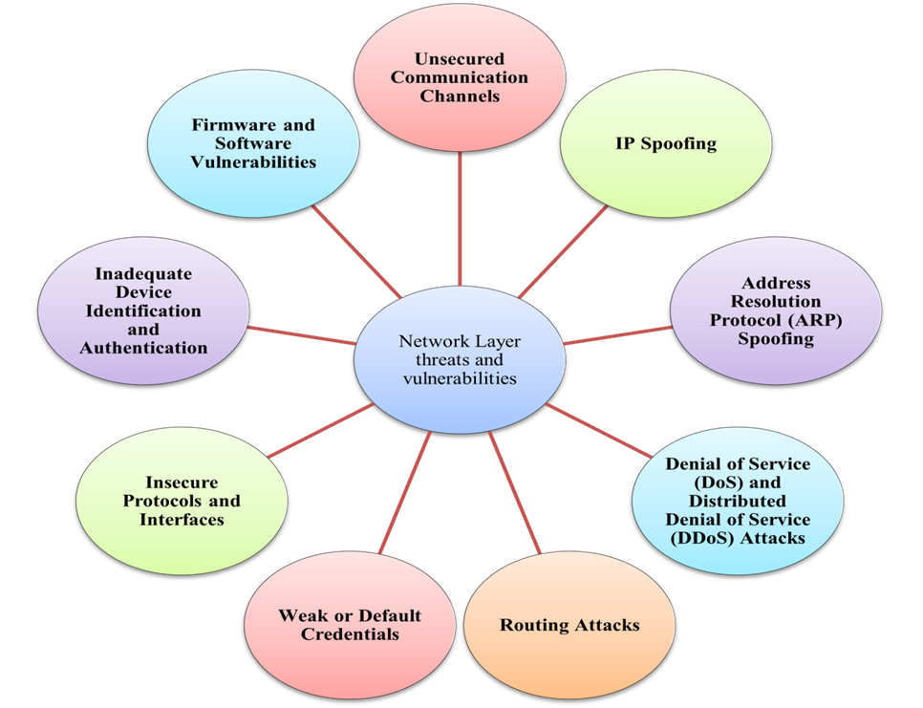
IoT threats and vulnerabilities in IoT systems- Network layer challenges

Slide 68
1.Unsecured Communication Channels:
–Threat: Many IoT devices transmit data over unencrypted or weakly encrypted networks.
–Vulnerability: Lack of encryption can expose data to interception and tampering.
2.IP Spoofing:
–Threat: Attackers can forge IP addresses to impersonate legitimate devices.
–Vulnerability: Spoofed IP addresses can bypass authentication mechanisms.
3.Address Resolution Protocol (ARP) Spoofing:
–Threat: Attackers send false ARP messages to associate their MAC address with the IP address of another device.
–Vulnerability: This can disrupt the normal operation of the network by redirecting or intercepting traffic.

Slide 69
4.Denial of Service (DoS) and Distributed Denial of Service (DDoS) Attacks:
–Threat: Attackers overload the network or devices with excessive traffic or requests.
–Vulnerability: Many IoT devices have limited processing power and bandwidth.
5.Routing Attacks:
–Threat: Manipulation of routing protocols or tables to alter data paths.
–Vulnerability: Some IoT networks use dynamic routing protocols that can be exploited.
6.Weak or Default Credentials:
–Threat: Devices often come with default or weak credentials that are not changed by users.
–Vulnerability: Easy-to-guess or default passwords can be exploited.

Slide 70
7.Insecure Protocols and Interfaces:
–Threat: Usage of outdated or insecure network protocols and interfaces.
–Vulnerability: Some protocols have known vulnerabilities that can be exploited.
8.Inadequate Device Identification and Authentication:
–Threat: Insufficient mechanisms for verifying the identity of devices.
–Vulnerability: Devices may be unable to prove their authenticity effectively.
9.Firmware and Software Vulnerabilities:
–Threat: Devices may run outdated or insecure firmware and software.
–Vulnerability: Known vulnerabilities in firmware can be exploited.

Slide 71
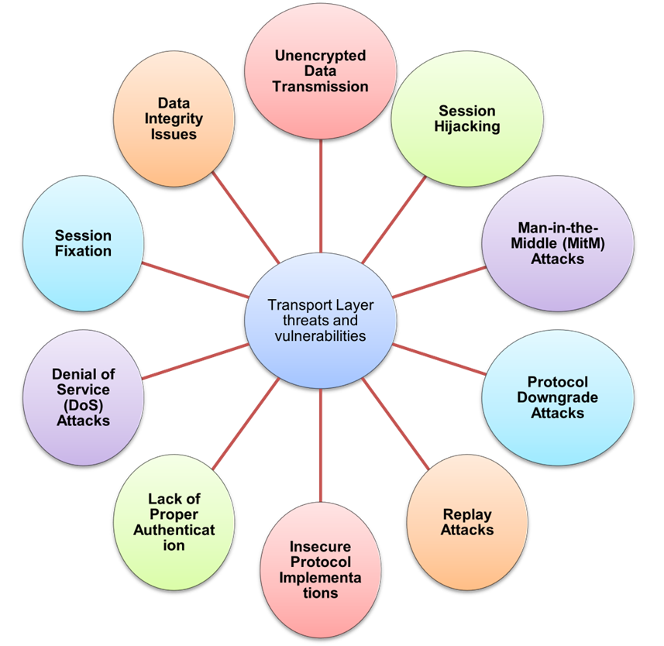
IoT threats and vulnerabilities in IoT systems- Transport layer challenges

Slide 72
Transport Layer Threats and Vulnerabilities in IoT
1.Unencrypted Data Transmission:
•Threat: Data transmitted over the transport layer may not be encrypted.
•Vulnerability: Lack of encryption allows data to be intercepted or tampered with.
2.Session Hijacking:
•Threat: Attackers take over a valid communication session between devices.
•Vulnerability: Inadequate session management and authentication.
3.Man-in-the-Middle (MitM) Attacks:
•Threat: Attackers intercept and potentially alter communication between two parties.
•Vulnerability: Lack of proper encryption and authentication mechanisms.
4.Protocol Downgrade Attacks:
•Threat: Attackers force devices to use weaker, less secure versions of communication protocols.
•Vulnerability: Devices fall back to older, vulnerable protocols when newer ones are available.

Slide 73
5.Replay Attacks:
•Threat: Attackers capture and replay valid data transmissions to deceive the receiver.
•Vulnerability: Lack of mechanisms to verify the freshness of messages.
6.Insecure Protocol Implementations:
•Threat: IoT devices may use outdated or flawed implementations of transport protocols.
•Vulnerability: Implementation flaws or deviations from standards.
7.Lack of Proper Authentication:
•Threat: Insufficient mechanisms to authenticate the parties involved in communication.
•Vulnerability: Weak or absent authentication methods.
8.Denial of Service (DoS) Attacks:
•Threat: Attackers flood the transport layer with excessive traffic.
•Vulnerability: Limited capacity to handle large volumes of data or requests.

Slide 74
9.Session Fixation:
•Threat: Attackers fixate on a session identifier to hijack a session.
•Vulnerability: Predictable or insecure session identifiers.
10.Data Integrity Issues:
•Threat: Data sent over the transport layer may be subject to tampering or corruption.
•Vulnerability: Lack of integrity checks or validation.

Slide 75
IoT GATEWAYS AND SECURITY
An internet of things (IoT) gateway is a physical device or software program that serves as the connection point between the cloud and IoT devices, such as controllers, sensors and smart devices. IoT gateways act as a central hub, connecting IoT devices to the cloud. Organizations can use gateways to connect IoT devices for data processing as well as to monitor and manage IoT devices.
All data moving between IoT-connected devices and the cloud passes through an IoT gateway, which can be either a dedicated hardware appliance or an application. An IoT gateway might also be referred to as an intelligent gateway or a control tier.
An IoT gateway acts as a network router, routing data between IoT devices and the cloud. Early on, most gateway devices only sent traffic in one direction: from the IoT device to the cloud. Now it's common for gateway devices to handle both inbound and outbound traffic. Outbound traffic streams are used to send IoT data to the cloud, while inbound traffic is used for device management tasks, such as updating firmware.

Slide 76
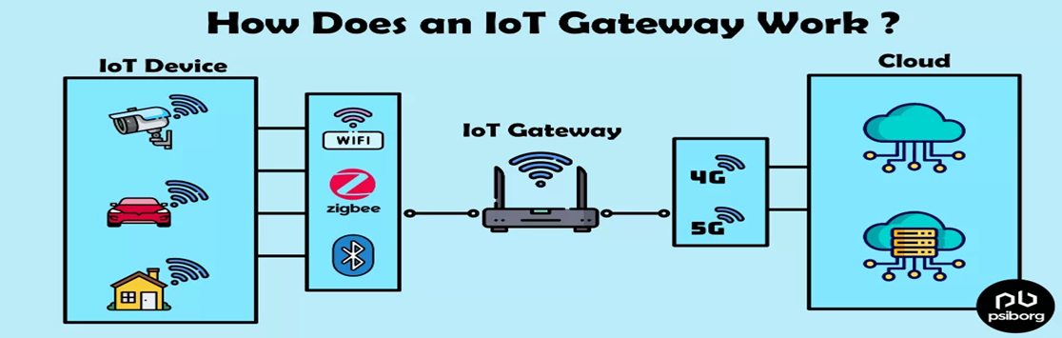
IoT GATEWAYS AND SECURITY

Slide 77
•Some IoT gateways do more than just route traffic, they can also preprocess data locally at the edge before sending it to the cloud. In doing so, the device might deduplicate, summarize or aggregate data as a way of reducing the volume of data that must be forwarded to the cloud. This can improve response times and reduce network transmission costs.
•A simple IoT gateway functions similarly to a Wi-Fi router. An IoT system connects to the gateway using a Wi-Fi connection and the gateway routes the IoT device data to the cloud.
•To improve IoT gateway security, organizations can do the following:
–Use only authenticated IoT gateways.
–Perform security assessments before implementation.
–Keep gateway software updated.
–Regularly review gateway access.
–Include gateways in security audits.
–Use a separate network for IoT gateways and devices.

Slide 78
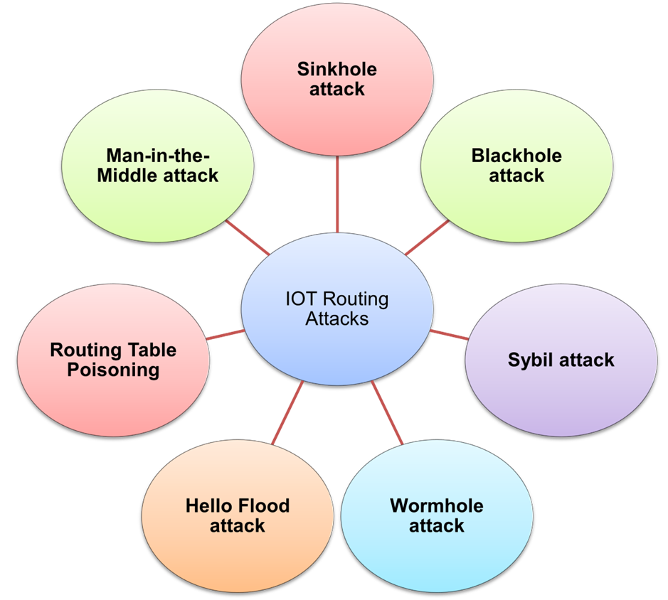
IoT Routing attacks

Slide 79
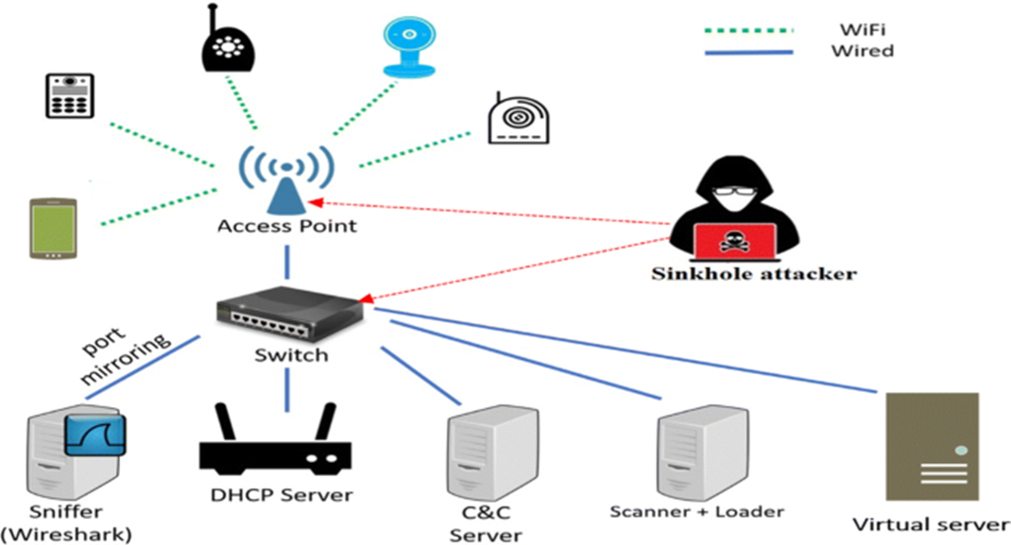
1. Sinkhole Attack
Description: An attacker creates a "sinkhole" node that attracts all the network traffic by falsely advertising itself as the best route to the destination. This can lead to network congestion, increased latency, and data loss.
Impact: Reduced network performance, data interception, or disruption of network services.

Slide 80
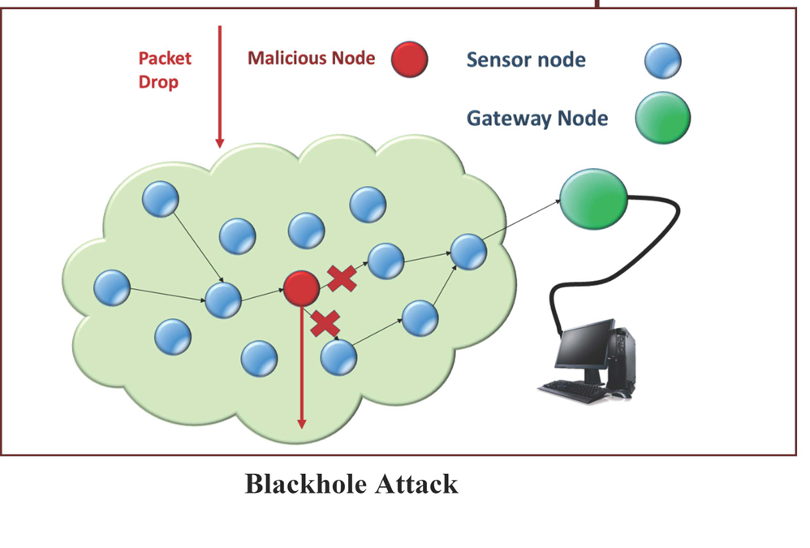
2. Blackhole Attack
Description: Similar to a sinkhole attack, in a blackhole attack, a malicious node claims to have the shortest path to the destination but then drops the incoming packets without forwarding them.
Impact: Loss of data packets and degraded network performance.

Slide 81
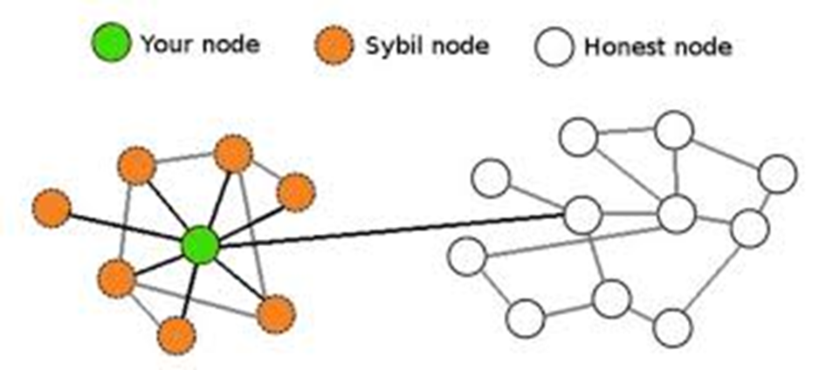
3. Sybil Attack
Description: An attacker creates multiple fake identities or nodes in the network to manipulate routing decisions or disrupt the network.
Impact: Compromised routing decisions, network congestion, and reduced reliability of the network.

Slide 82
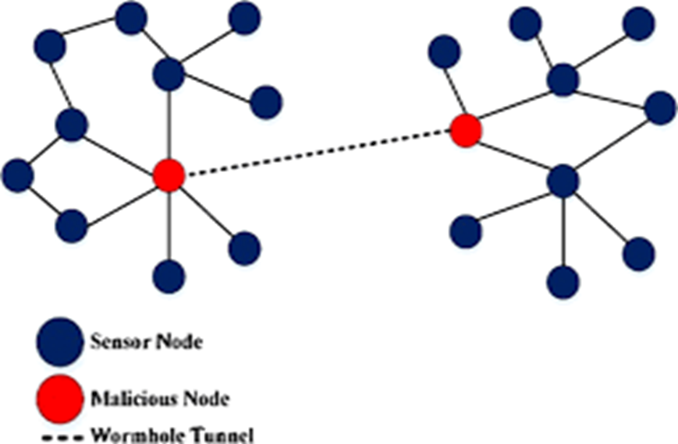
4. Wormhole Attack
Description: An attacker creates a tunnel between two compromised nodes, allowing them to transmit data quickly across the network while avoiding legitimate nodes.
Impact: Disruption of normal routing protocols and potential data interception.

Slide 83
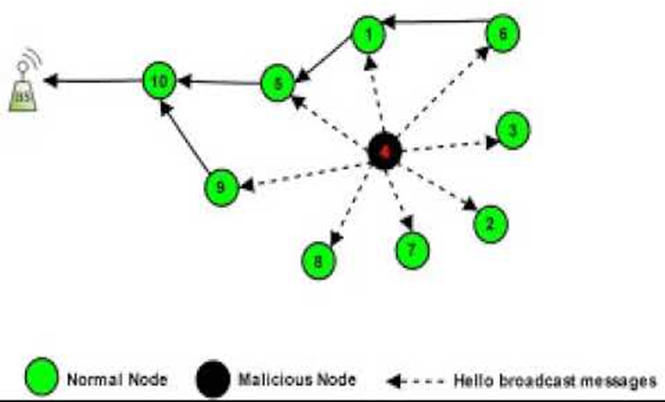
5. Hello Flood Attack
Description: An attacker sends numerous "Hello" messages to a network to overload the routing protocol or to make other nodes believe the attacker is a legitimate part of the network.
Impact: Increased network traffic and potential denial of service.

Slide 84
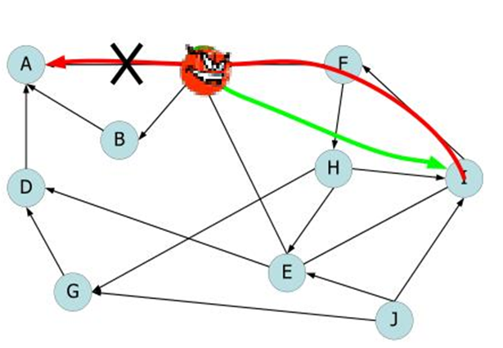
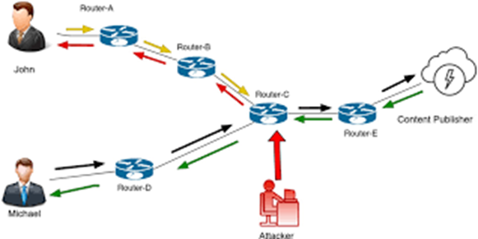
6. Routing Table Poisoning
Description: An attacker injects incorrect routing information into the network, causing legitimate nodes to route traffic incorrectly.
Impact: Data loss, increased latency, and potential network outages.

Slide 85
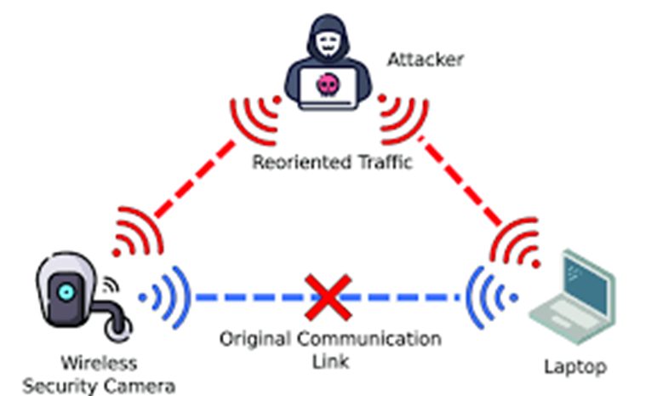
7. Man-in-the-Middle Attack
Description: An attacker intercepts and potentially alters communication between nodes in the network.
Impact: Data breaches and unauthorized access to sensitive information.

Slide 86
Authorization Mechanism
•Authorization in the Internet of Things (IoT) refers to the process of granting or denying access to resources and services based on the identity of the requesting entity. This mechanism ensures that only authorized devices, users, or applications can access specific data or perform certain actions within an IoT ecosystem.
•Key Components of IoT Authorization are:
a) Access Control Lists (ACLs):
Define which users or devices have access to specific resources.
Example: A smart home system where only the homeowner’s smartphone can control the security cameras.

Slide 87
b) Role-Based Access Control (RBAC):
Assigns permissions based on roles rather than individual identities.
Example: In a smart factory, different roles like operator, supervisor, and maintenance staff have varying levels of access to machinery controls.
c) Attribute-Based Access Control (ABAC):
Uses attributes (e.g., user role, time of day, location) to determine access rights.
Example: A healthcare IoT system where access to patient data is granted based on the healthcare provider’s role and the time of access.
d) OAuth:
A widely used authorization framework that allows third-party applications to access user data without exposing credentials.
Example: A fitness app accessing data from a user’s wearable device using OAuth tokens.

Slide 88
Symmetric-Key LWC Algorithms
Tiny Encryption Algorithm (TEA)
block cipher
renowned for its simplicity of description and implementaton, typically a few lines of code
uses a large number of iterations, rather than a complicated program, in order to avoid preset tables and long setup times
uses 128-bit key
TEA family: XTEA (extended TEA), XXTEA, Block TEA, Speed TEA, and Tiny TEA
uses very simple operations (addition, XORing, shifts), and has a very small code size; ideal candidate for small objects and wireless sensors

Slide 89
Symmetric-Key LWC Algorithms
The Scalable Encryption Algorithm (SEA) is targeted for small embedded applications. The design explicitly accounts for an environment with very limited processing resources and throughput requirements. A design principle of SEA is flexibility: the plaintext size n, key size n, and processor (or word) size b are design parameters, with the only constraint that n is a multiple of 6b; for this reason, the algorithm is denoted as SEAn;b. The main disadvantage is that SEAn;b trades space for time and this may not be trivial on devices with limited computational power.

Slide 90
Symmetric-Key LWC Algorithms
Scalable Encryption Algorithm (SEA)
is targeted for small embedded applications
considers the limited processing resources and throughput requirements
provides flexibility
design parameters – plaintext size, key size, processor size
motivation for this flexibility
– many encryption algorithms perform differently depending on the platform, e.g., 8- bit or 32-bit processors.
SEA is designed to be generic and adaptable to different security levels and target hardware
has the ‘on-the-fly’ key derivation feature

Slide 91
Symmetric-Key LWC Algorithms
PRESENT is an ultra-lightweight block cipher algorithm based on a Substitution-Permutation Network (SPN) . PRESENT has been designed to be extremely compact and efficient in hardware. It operates on 64-bit blocks and with keys of either 80 or 128 bits. It is for use in situations where low-power consumption and high chip efficiency are desired, thus making it of particular interest for constrained environments.

Slide 92
Symmetric-Key LWC Algorithms
PRESENT Cipher
ultra-lightweight block cipher algorithm based on a Substitution- Permutation Network
designed to be extremely compact and efficient in hardware
intended to be used in situation where low-power consumption and high chip efficiency are desired, thus making it of particular interest for constrained environments.
is also simple
ISO/IEC 29192-2:2012 “Lightweight Cryptography” specifies PRESENT as a block cipher suitable for lightweight cryptography.

Slide 93
Symmetric-Key LWC Algorithms
The HIGh security and lightweigHT (HIGHT) encryption algorithm is a generalized Feistel network with a block size of 64 bits, 128-bit keys, and 32 rounds. HIGHT was designed with an eye on low-resource hardware performance. HIGHT uses very simple operations, such as XORing, addition mod 28, and bitwise rotation

Slide 94
Symmetric-Key LWC Algorithms
HIGHT
HIGh security and light weigHT encryption algorithm is a generalized Feistel network
uses very simple operations such as XORing, addition, and bitwise rotation

Slide 95
Symmetric-Key LWC Algorithms
LWC algorithms are applicable to those scenarios such as
a moderate security level is required
encryption should not be applied to large amounts of data
hardware area needed for implementation and the power consumption are considered harder requirements than speed
For smart objects, need to focus on
efficient software implementation
performing well in hardware in terms of speed and energy consumption

Slide 96
Asymmetric LWC Algorithms
TPublic-key (asymmetric) cryptography requires the use of a public-key and a private key. Public keys can be associated with the identity of a node by including them into a public certificate, signed by a Certification Authority (CA) that can be requested to verify the certificate. Public-key cryptography requires the significant effort of deploying a PKI. Moreover, asymmetric cryptography requires higher processing and long keys (at least 1024 bits for RSA ) to be used.
Alternative public-key cryptographic schemes, such as ECC, might require shorter keys to be used in order to achieve the same security than RSA keys. However, because of these reasons, symmetric cryptography is preferred in terms of processing speed, computational effort, and size of transmitted messages. Public key can be used to setup symmetric keys to be used in subsequent communications.
Lightweight cryptography algorithms are suitable for environments that do not have stringent security requirements and where the constraints on available hardware and power budget cannot be relaxed.

Slide 97
Asymmetric LWC Algorithms
Elliptic Curve Cryptography (ECC)
provides higher security and a better performance than the first generation public-key techniques (RSA and Diffie-Hellman).
the most interesting public-key cryptographic family for embedded environments
can reach the same security level as RSA with much shorter keys
computationally lighter operations, like addition and multiplication, rather than exponentiation
accepted commercially, adopted by standardizing institutions such as ANSI, IEEE, ISO, SECG, and NIST

